Slide 1
Obstacle Avoiding Vehicle
Devesh Kumar Pandey
Roll No.- 2101MC16
Mathematics and Computing

Slide 2
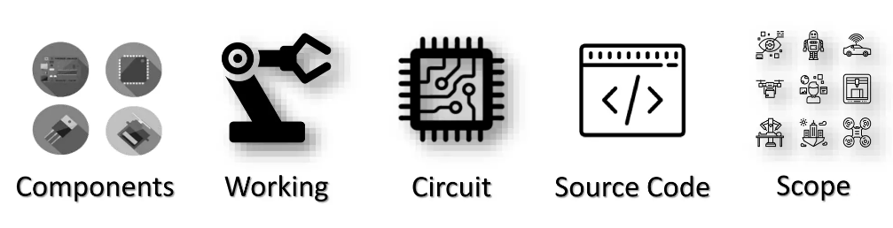
Contents

Slide 3
Introduction:
Now day’s Electric Vehicle are in high demand due to their high level of performance and reliability and which is a great help for human beings. The obstacle avoidance is used for detecting obstacles and avoiding the collision. This is an autonomation of vehicle. The design of the obstacle avoidance vehicle requires the integration of many sensors according to their task.
Obstacle detection is the primary requirement of this automated vehicle. The Vehicle gets the information from the surrounding area through mounted sensors on the its body. Some sensing devices used for obstacle detection like bump sensors, infrared sensors, ultrasonic sensors, etc. The ultrasonic sensor is most suitable for obstacle detection and it is of low cost and has a high ranging capability.

Slide 4
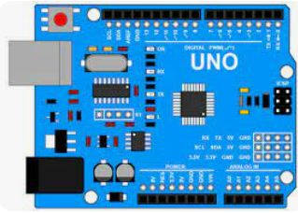
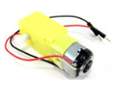
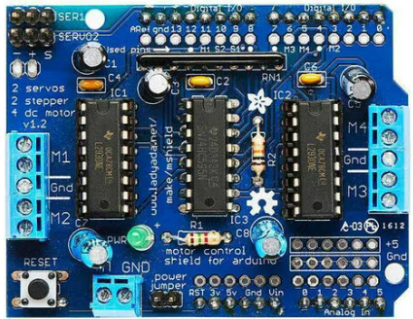
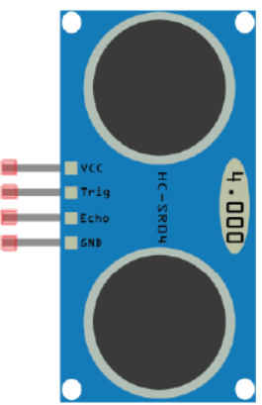
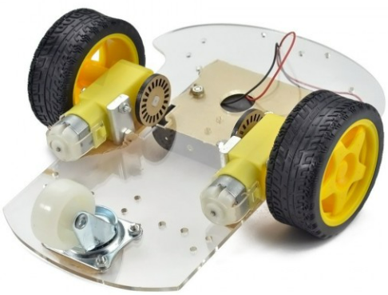
Components
Arduino Uno R3
2 DC Motors
Motor Driver
HCSR04 Ultrasonic Sensor
Chassis

Slide 5
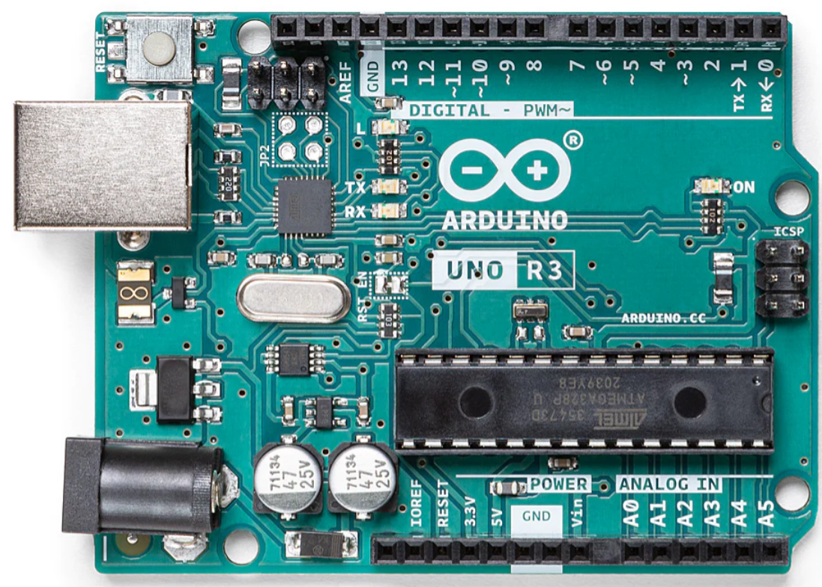
Arduino Uno
Open Source Hardware: Schematics
• Arduino Uno is open-source hardware! You can build your own board
Programming
• The UNO is the best board to get started with electronics and coding
• The Arduino Uno can be programmed with the Arduino Software IDE
• It can be used with various sensors and actuators.
Power
The Arduino Uno board can be powered via the USB connection or with an external power supply from 6 to 20 volts. The power source is selected automatically.

Slide 6
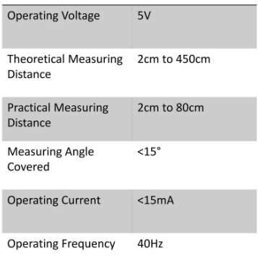
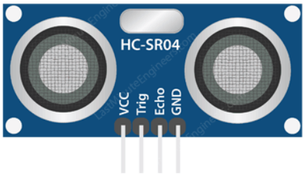
HC-SR04 Ultrasonic Sensor
It is a non-contact based distance measurement system and can measure distance of 2cm to 4m.
Ultrasonic sensor is mainly use to detect the obstacle

Slide 7
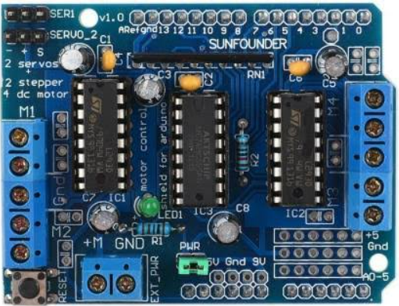
L293D Motor Driver Shield
It is capable of controlling 4x bidirectional DC motors, 2x unipolar/bipolar stepper motors, 2x small servo motors.
The brains of the shield are two L293D (dual-channel H-Bridge motor driver that can control two DC motors or a single stepper motor) motor drivers and a 74HC595 shift register (extends the Arduino’s four digital pins to the eight direction control pins of two L293D chips).

Slide 8
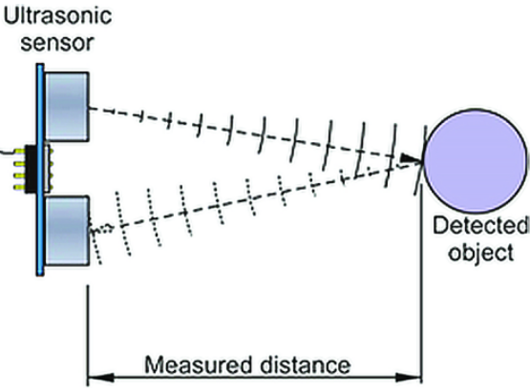
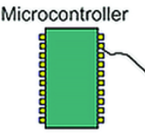

Working

Slide 9
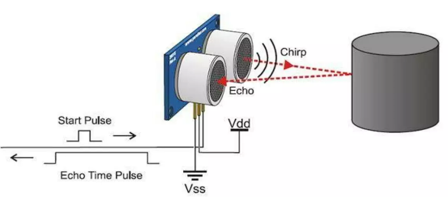
Calculating Distance
Ultrasonic signals travel at the speed of sound
At 20°C the speed of sound is 343 m/s
Time measured by HC-SRO4 is for return trip
Divide time in half to calculate distance
D = (Δt/2) × c
Δt = Time Delay
c=Speed of Sound
D = Distance Measured

Slide 10
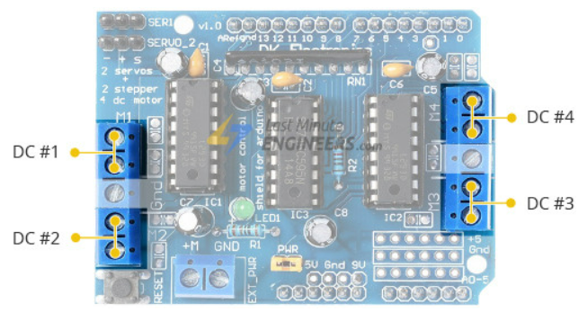
Controlling the Speed and Direction of DC Motor
The output channels of both L293D ICs are broken out to the edge of the shield with two 5-pin screw terminals labeled M1, M2, M3, and M4.
A total of four DC motors operating at 4.5 – 25V can be connected to these terminals.

Slide 11

Circuit

Slide 12
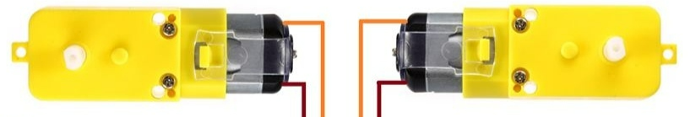
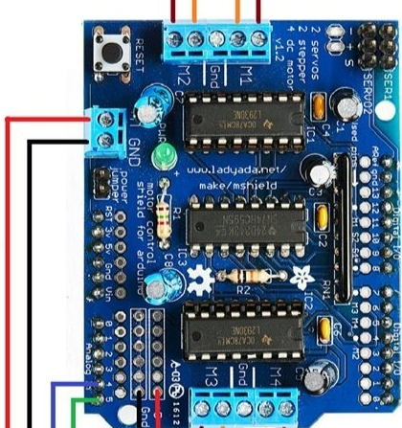
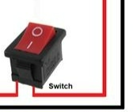
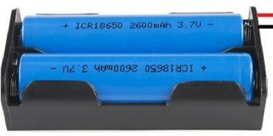
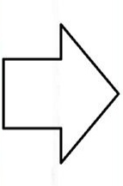
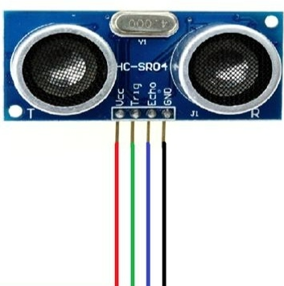


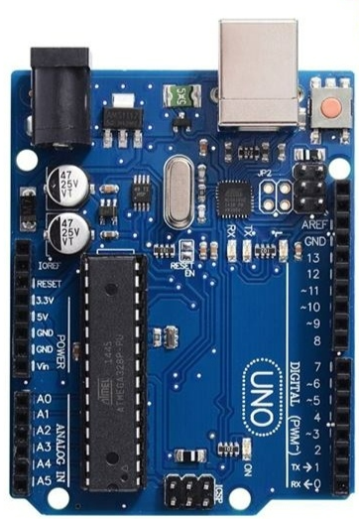
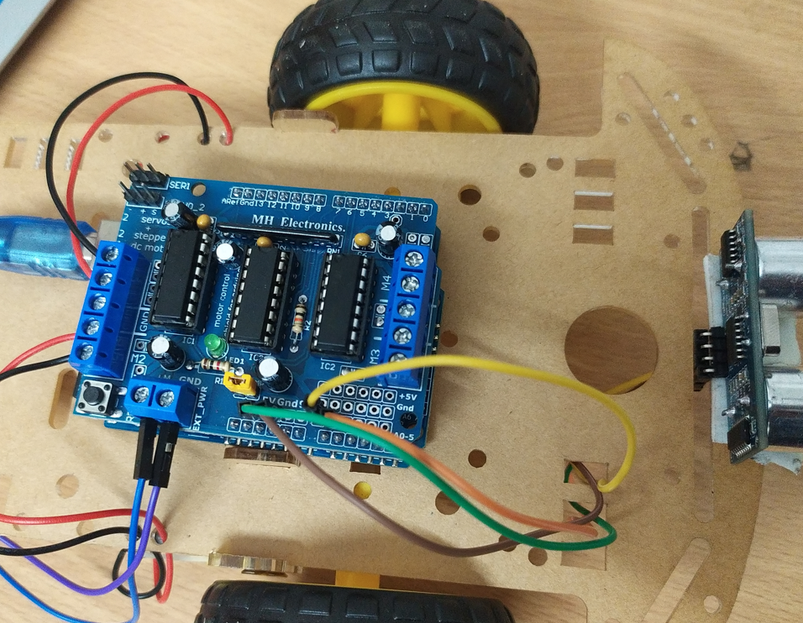







Circuit
Motor Driver mounted over Arduino Uno
Power Source

Slide 13







Source Code

Slide 14
Move Forward Function
Move Backward Function
void moveForward() {
if (!goesForward) { // If area is clear, motors move forward
goesForward = true;
motor1.run(FORWARD);
motor2.run(FORWARD);
// Slowly bring up speed to avoid loading down
// batteries too quickly
for (speedSet = 0; speedSet < MAX_SPEED; speedSet += 2) {
motor1.setSpeed(speedSet);
motor2.setSpeed(speedSet);
delay(1);}
}
}
void moveBackward() {
goesForward = false;
motor1.run(BACKWARD);
motor2.run(BACKWARD);
// Slowly bring up speed to avoid loading down
// batteries too quickly
for (speedSet = 0; speedSet < MAX_SPEED; speedSet += 2) {
motor1.setSpeed(speedSet);
motor2.setSpeed(speedSet);
delay(1);
}
}

Slide 15
Turn Right Function
Turn Left Function
void turnRight() { // Movement for turning right
motor1.run(FORWARD);
motor2.run(BACKWARD);
delay(89);
motor1.run(FORWARD);
motor2.run(FORWARD);
}
void turnLeft() { // Movement for turning left
motor1.run(BACKWARD);
motor2.run(FORWARD);
delay(89);
motor1.run(FORWARD);
motor2.run(FORWARD);
}
Move Stop Function
Distance Calculator Function
int readPing() {
delay(20);
int cm = sonar.ping_cm();
if (cm == 0) {
cm = 250;}
return cm;}
void moveStop() {
motor1.run(RELEASE);
motor2.run(RELEASE);
}

Slide 16
Pin Declaration and Arduino Set up code
Arduino Loop Code
#include <NewPing.h>
#include <AFMotor.h>
#define TRIG_PIN A5
#define ECHO_PIN A4
#define MAX_DISTANCE 200
#define MAX_SPEED 90 // Sets speed of DC motors NewPing sonar(TRIG_PIN, ECHO_PIN, MAX_DISTANCE);
AF_DCMotor motor1(1, MOTOR12_1KHZ); // First motor to connection 1
AF_DCMotor motor2(2, MOTOR12_1KHZ); // Second motor to connection 2
boolean goesForward = false;
int distance = 100; // Define an int for distance and speed
int speedSet = 0;
void setup() {
distance = readPing(); // Read the distance from the sensor
delay(100);
}
void loop() {
delay(40);
// If distance is less than 10 cm, carry out this function
if (distance <= 10) {
moveStop();
delay(50);
moveBackward();
delay(100);
moveStop();
delay(100);
turnLeft();
moveStop();
} else {
moveForward();
}
distance = readPing();
}

Slide 17

Scope

Slide 18
Scope
Further Improvements and Future Scope
1.By adding servo motor, We can check other directions.
2. Adding a Camera
If interfaced with a camera, Vehicle can be driven beyond line of sight Range becomes practically unlimited as network have a large range
3. Use as a fire fighter robot
Addition of temperature sensor, water tank required
Required some changes in programming
It can work as an autonomous fire extinguisher.
4. Obstacle detection for a Mining Vehicle.
5. Driverless vehicles running along beams.
6. Obstacle detecting system for a motor vehicle.
7. Autonomous cleaning robot.

Slide 19
Thank You!

